Slide 1
Essay writing
Mr Richard Warner and Dr Julia Miller English for Uni
www.adelaide.edu.au/english-for-uni

Slide 2

The teaching materials in this PowerPoint presentation have been developed by Richard Warner and Julia Miller, and are available on the English for Uni website.
Funded by the Australian Government Office for Learning and Teaching.

Slide 3
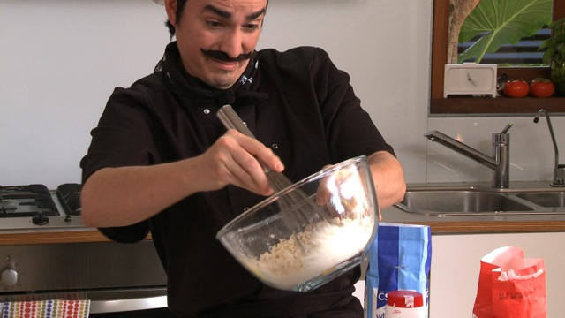
Essay Chef
Please click on the photo above to go to the Essay Chef video
Notes:
Click on photo to watch video of cooking show online, or paste this link into your browser:
https://www.youtube.com/watch?v=31aGSpaoAYw&feature=youtu.be&list=PLrj2iJKdUdbwJzcAgjy_X44Oo4jLXUlog

Slide 4
What did Gordon do wrong?
Notes:
Brainstorm ideas for what students need to think about when writing an essay.
See next slide for suggestions.

Slide 5
What do you need to consider when writing an essay?
topic/title
structure
research
content
paragraphs
argument
drafting
referencing
proofreading
introduction
incorporating your own voice
conclusion
Notes:
Click arrow or mouse to reveal these suggestions.

Slide 6
Referencing while maintaining your own voice
So many referencing styles
Paraphrasing
Quoting
How do we incorporate paraphrases and quotes, but still be in charge of the essay?

Slide 7
Including other voices - author prominent
Parker, Parker and Brotchie (2006) say that high carbohydrate foods such as chocolate do have a ‘feel good’ effect. Moreover, Scholey and Owen (2013) in a systematic review of the literature in the field, point to several studies, such as Macht and Dettmer (2006) and Macht and Mueller (2007), which appear to confirm this effect. Parker, Parker and Brotchie (2006, p. 150) note that the mood effects of chocolate “are as ephemeral as holding a chocolate in one’s mouth”. Macht and Dettmer (2006) have done research on longer term mood affecting influences of chocolate. Macht and Dettmer (2006) also study stress that “temporal tracking of [both] positive and negative emotions” (p.335) before and after consuming chocolate in future studies could help in further understanding the ‘feel good’ effect and more negative emotions.

Slide 8
Including other voices - idea prominent
Consumption of chocolate is something that many enjoy, and there is evidence (Parker, Parker, & Brotchie, 2006) that high carbohydrate foods such as chocolate do have a ‘feel good’ effect. Moreover, Scholey and Owen (2013) in a systematic review of the literature in the field point to several studies, such as Macht and Dettmer (2006) and Macht and Mueller (2007), which appear to confirm this effect. Yet, as Parker, Parker and Brotchie (2006, p. 150) note, the mood effects of chocolate “are as ephemeral as holding a chocolate in one’s mouth”. In addition, mood is something that is difficult to isolate and quantify, and aside from the study by Macht and Dettmer (2006) there appears to be little research on any longer term mood affecting influences of chocolate.

Slide 9
Whose voice predominates?
there has been debate on academic literacies “since the 1970s”
“referentially: that is as referring to reading/writing texts in academic contexts, rather than as indexing a critical field of inquiry with specific theoretical and ideological historical roots or interests”. there is debate over the possibility of teaching academic literacy skills in a single semester
“a common institutional practice . . . to teach students study skills with the assumption that they would be transferable to other contexts”
Nallaya and Kehrwald (2013) explain that
(p. A80). In this paper, the term
‘academic literacy’ is used, as Lillis and Scott (2007, p. 7) say it is often used,
Moreover,
(Nallaya & Kehrwald, 2013), and it is
(Nallaya & Kehrwald, 2013, p. A80).
Other writers’ voices are dominant
Notes:
Yellow – student
Grey – indirect external voice (paraphrase)
Green – direct external voice (quotes)

Slide 10
Whose voice predominates?
In this paper, the term ‘academic literacy’ is used, as Lillis and Scott (2007, p. 7) say it is often used,
“referentially: that is as referring to reading/writing texts in academic contexts”.
there is debate over the possibility of teaching academic literacy skills in a single semester
In other words, it is framed instrumentally, rather than epistemologically, and is related to specific practices which teach student writers the skills needed to write an academic assignment. Although
(Nallaya & Kehrwald, 2013), many universities in Australia include generic courses to teach skills related to reading, writing, referencing and research, and the study in this paper was based on one such course, for which the researcher was also the class instructor and course designer.
The student writer’s voice is dominant.
Notes:
Try exercise 3 from the website, either online or from the downloadable handout.

Slide 11
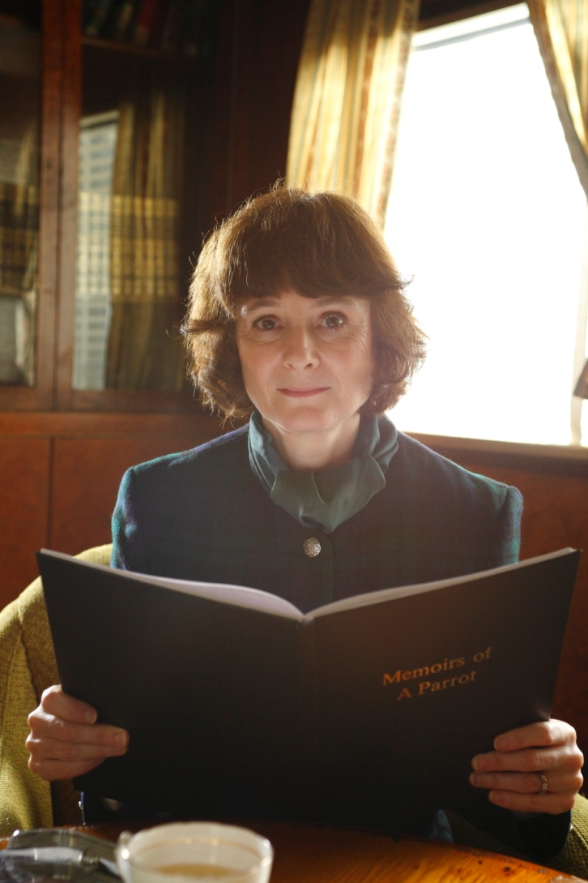
Teaching on essay writing
Notes:
Play the teaching part of the Essay Chef video to remind students of the things to consider when writing an essay.
Click on the photo to go straight to the clip on YouTube, or paste this link into your browser: https://www.youtube.com/watch?v=xR3o2WiflXw&feature=youtu.be&list=PLrj2iJKdUdbwJzcAgjy_X44Oo4jLXUlog

