Slide 1
Making Sense of Statistics
Research and Critical Appraisal
Dr David Butler
Maths Learning Centre
University of Adelaide
Semester 1 2022

Slide 2
You NEED statistics because things VARY
You want to:
describe how things vary
figure out what is usual
predict the variation
control the variation

Slide 3
Statistics is for answering questions using data
When you do statistics, you use the data to:
draw graphs
calculate numbers
perform statistical tests
create mathematical formulas for predicting things

Slide 4
Some research questions are about a single concept
For example:
How much salt is there in an avocado?
What percentage of people experience joint pain?
How much cloud cover does Adelaide have in March?
Do the majority of ice-creams have the amount of fat in them that the nutrition information says?

Slide 5
MOST research questions are about the relationship between concepts
For example:
Are science fiction books thicker than other books?
How much of an effect does more sleep have on a student’s grades?
Does chilli in a meal make a difference to your body temperature?
How can you predict the air temperature from the amount of cloud cover?

Slide 6
WARNING!
Statistical calculations by themselves NEVER tell you whether anything CAUSES anything else.
(That’s what experimental design is for.)

Slide 7
For statistics to help, you have to turn concepts into variables by measuring them
For example, in the question “Does chilli in a meal make a difference to your body temperature?”, chilli could be measured as:
Whether a meal has chilli in it or not.
The classification of the meal as mild, medium or hot.
The exact amount of chilli powder added to the meal during cooking.
YOU HAVE TO DECIDE HOW YOU MEASURE

Slide 8
WARNING!
Statistical calculations by themselves NEVER tell you whether anything CAUSES anything else.
(That’s what experimental design is for.)
BUT
Statistics CAN help you CALCULATE what you expect one variable to be, from other variables.
Outcome variable
Explanatory variable

Slide 9
Where we’ve been
Research questions are about concepts and the relationships between them.
Concepts become variables when you measure them.
Statistics questions are about variables and the relationships between them.
Statistics can help you calculate one variable from others, but not decide if one thing causes another.
Where we’re going
What stats you do depends on:
What type of question you’re asking
Information about the variables

Slide 10
Types of statistical question and the stats that go with them
Purpose | Type of question | Type of statistics
Describe | What’s going on? | Descriptive statistics: graphs, percentages, means, correlations
Decide | Yes or no? | Hypothesis testing: test statistics and p-values
Estimate | What’s the number? | Confidence intervals
Predict | What’s the formula? | Modelling: regression

Slide 11
Hypothesis tests help decide answers to yes-or-no questions
How people create hypothesis tests | Official name
Imagine a world where one of the answers is true – whichever answer has only one way to be. | Null hypothesis
Choose a calculation where you can know all the answers that could be and how likely they all are. | Test statistic
Think about how likely the test statistic you got from your data is, compared to all the answers it could have been. | P-value
Choose a cutoff where you will say a p-value counts as low. | Significance level
If the p-value is low, your data is unlikely in the null hypothesis world, so you don’t believe you live in that world.
If the p-value is high, your data is likely in the null hypothesis world, so you do believe you might live in that world.

Slide 12
Information about the variables changes the statistical calculations you can do

Slide 13
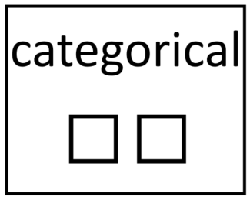
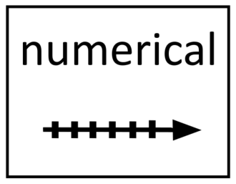
Two kinds of variables
CATEGORICAL
(also known as “qualitative”)
Words: how far apart has no meaning.
NUMERICAL
(also known as “quantitative”, “interval”, “scale”)
Numbers: how far apart has meaning.

Slide 14
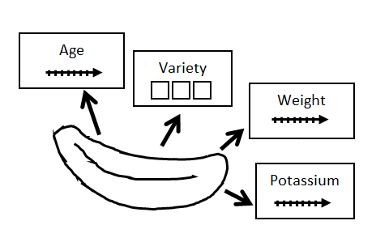
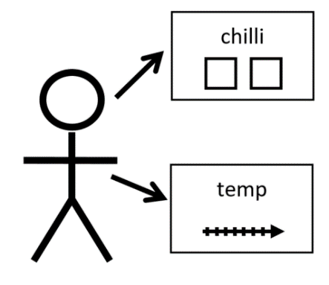
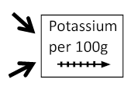
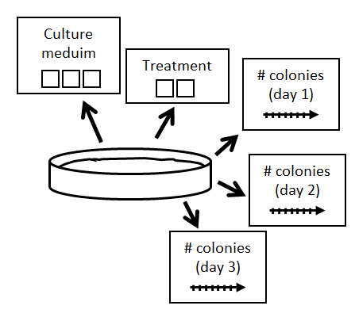
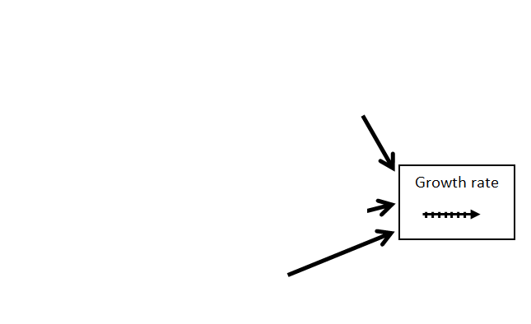
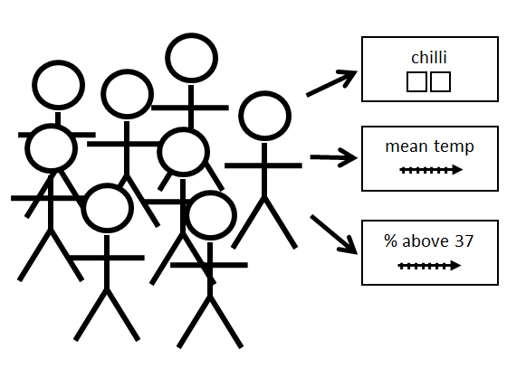
“Subjects” are sources of variables

Slide 15
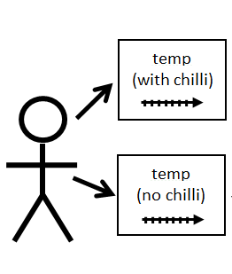
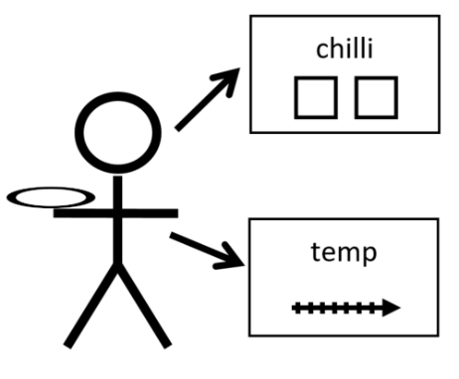
Categorical variables belong to subjects in different ways
Independent groups
Repeated measures

Slide 16
Distribution of numerical variables
The distribution of a variable is all the things it can possibly be and how likely all those options are.
approximately normal
not normal
more likely
in the middle
less likely on either side
just as likely one side as the other

Slide 17
Information about the variables changes the statistical calculations you can do
How many variables are involved
What kind of variables they are
Categorical variables – whether there are two categories or more than two
Categorical explanatory variables – whether they go with independent groups or repeated measures
Numerical outcome variables – whether the distribution is normal (probably doesn’t matter if sample size is large)

Slide 18
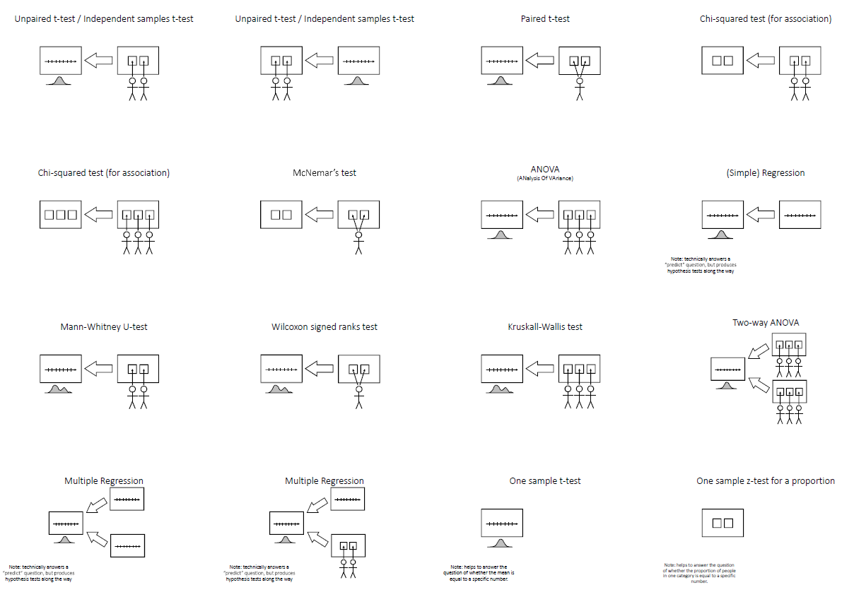
Thirteen common hypothesis tests

Slide 19
Unpaired t-test / Independent samples t-test

Slide 20
Unpaired t-test / Independent samples t-test

Slide 21
Paired t-test

Slide 22
Chi-squared test (for association)

Slide 23
Chi-squared test (for association)

Slide 24
McNemar’s test

Slide 25
ANOVA (ANalysis Of VAriance)

Slide 26
(Simple) Regression
Note: technically answers a “predict” question, but produces hypothesis tests along the way

Slide 27
Mann-Whitney U-test

Slide 28
Wilcoxon signed ranks test

Slide 29
Kruskall-Wallis test

Slide 30
Two-way ANOVA

Slide 31
Multiple Regression
Note: technically answers a “predict” question, but produces hypothesis tests along the way

Slide 32
Multiple Regression
Note: technically answers a “predict” question, but produces hypothesis tests along the way

Slide 33
One sample t-test
Note: helps to answer the question of whether the mean is equal to a specific number.

Slide 34
One sample z-test for a proportion
Note: helps to answer the question of whether the proportion of people in one category is equal to a specific number.

