Slide 1
Making Sense of Statistics Part 2
Research and Critical Appraisal
Dr David Butler
Maths Learning Centre
University of Adelaide
Semester 1 2022

Slide 2
Where we’ve been
Research questions are about concepts and the relationships between them.
Concepts become variables when you measure them.
Statistics questions are about variables and the relationships between them.
Statistics can help you calculate one variable from others, but not decide if one thing causes another.
What stats you do depends on:
What type of question you’re asking
Information about the variables

Slide 3
Types of statistical question and the stats that go with them
Purpose | Type of question | Type of statistics
Describe | What’s going on? | Descriptive statistics: graphs, percentages, means, correlations
Decide | Yes or no? | Hypothesis testing: test statistics and p-values
Estimate | What’s the number? | Confidence intervals
Predict | What’s the formula? | Modelling: regression

Slide 4
Information about the variables changes the statistical calculations you can do
How many variables are involved
What kind of variables they are
Categorical variables – whether there are two categories or more than two
Categorical explanatory variables – whether they go with independent groups or repeated measures
Numerical outcome variables – whether the distribution is normal (probably doesn’t matter if sample size is large)

Slide 5
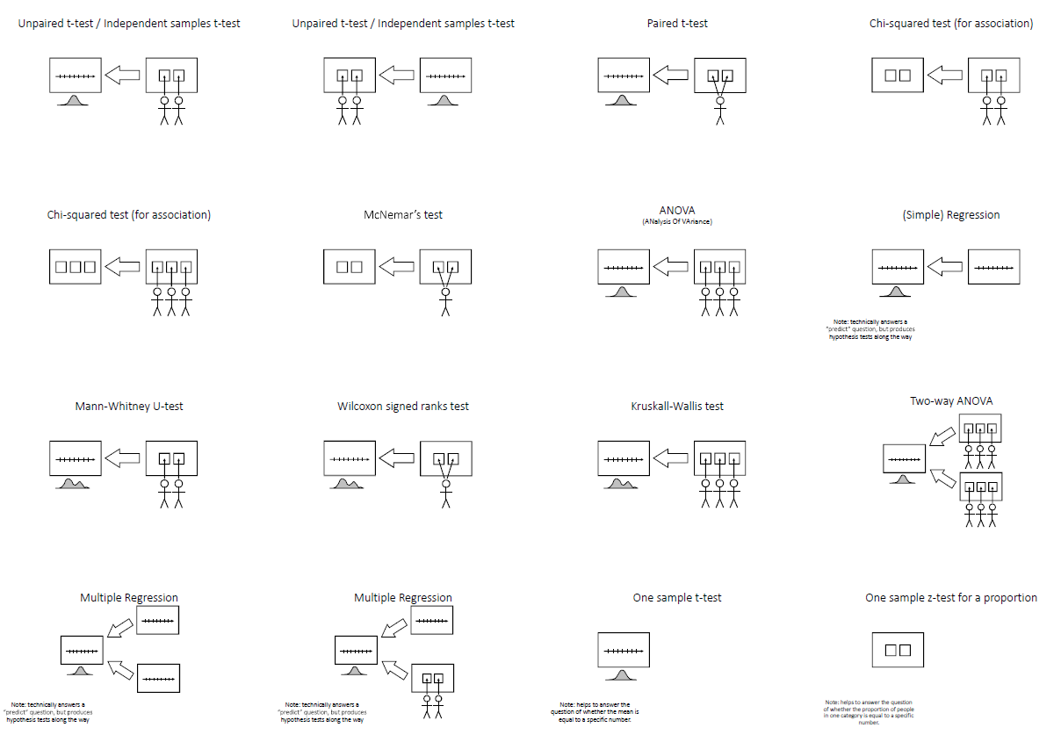
Thirteen common hypothesis tests

Slide 6
Sample size
How many participants you need for your research depends on the kind of data you have and the method you use to analyse it.
Different analysis methods need different amounts of data to reliably do their job.
You cannot choose a sample size until AFTER you have decided how you will analyse the data.

Slide 7
Sample size rule of thumb for hypothesis tests or regression with a numerical outcome
The absolute minimum subjects you need is at least 10 individual subjects for every numerical explanatory variable and each category of every categorical explanatory variable.
Harrell, F. E. Jr.; Lee, K. L.; Califf, R. M.; Pryor, D. B.; Rosati, R. A. (1984). "Regression modelling strategies for improved prognostic prediction". Stat Med. 3 (2): 143–52.

Slide 8
Things that affect sample size in hypothesis tests
Smaller sample size | Consideration | Bigger sample size
Numerical outcome variables | Type of outcome variable | Categorical outcome variables
Repeated measures | What categorical explanatory variables tell you to do | Independent groups
Looking for a big difference | Size of the difference you are looking for | Looking for a small difference
Low variability | Variability in what could happen in a sample | High variability
Higher significance level | Significance level (p-value cut-off for declaring a significant result) | Lower significance level
Lower power | Power (chance of finding a relationship if it really is there to find) | Higher power

Slide 9
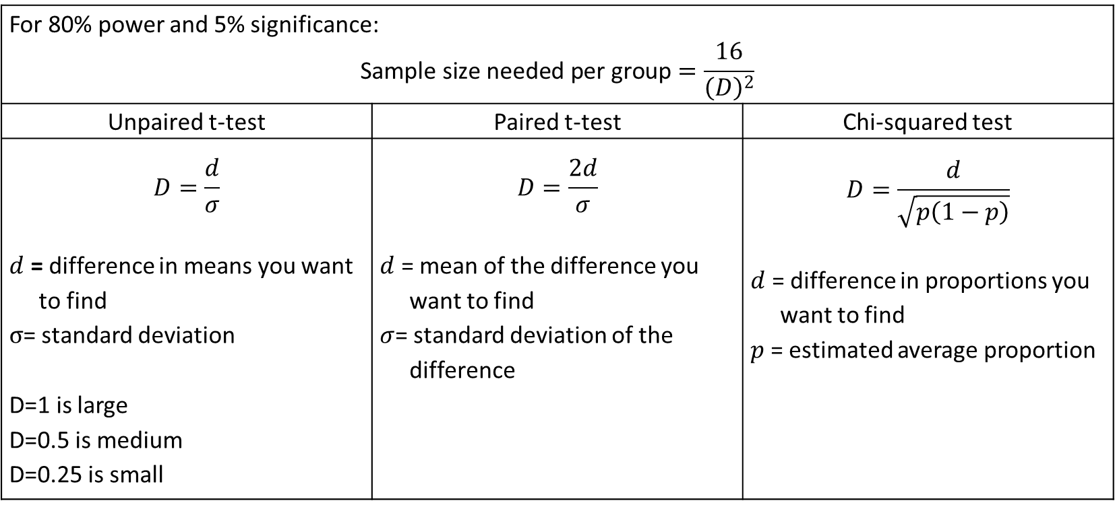
Sample size calculations with Lehr’s formula
These are complicated, and need professional assistance. But you can start with Lehr’s Formula, a rough calculation presented in Chapter 26 of “Medical Statistics at a Glance” by Aviva Petrie and Caroline Sabin.
For 80% power and 5% significance: $$\text{Sample} \text{size} \text{needed} \text{per} \text{group}=\frac{16}{{\left(D\right)}^{2}}$$
Unpaired t-test | Paired t-test | Chi-squared test
$$D=\frac{d}{σ}$$ $d$ = difference in means you want to find $σ$= standard deviation D=1 is large D=0.5 is medium D=0.25 is small | $$D=\frac{2d}{σ}$$ $d$ = mean of the difference you want to find $σ$= standard deviation of the difference | $$D=\frac{d}{\sqrt{p\left(1−p\right)}}$$ $d$ = difference in proportions you want to find $p$= estimated average proportion

